Slide 1
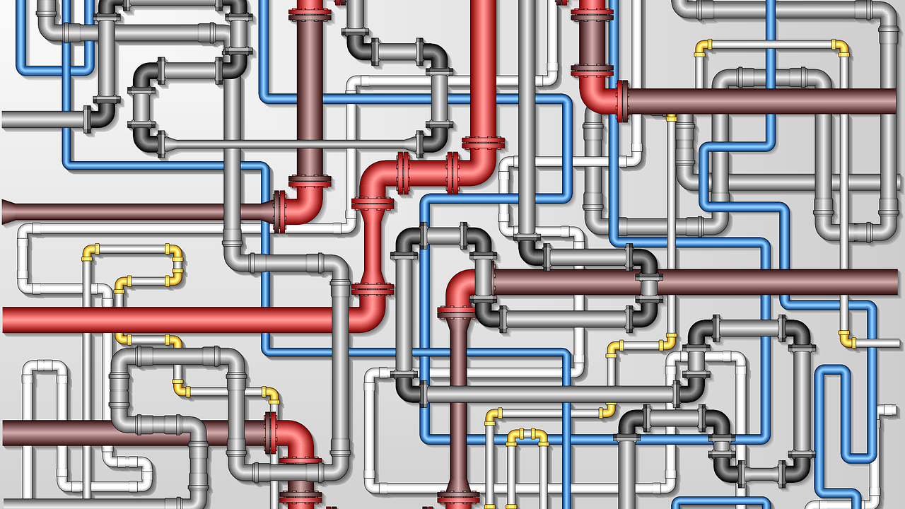
THE PIPELINE
Martha Hunn
Senior Vice President

Slide 2
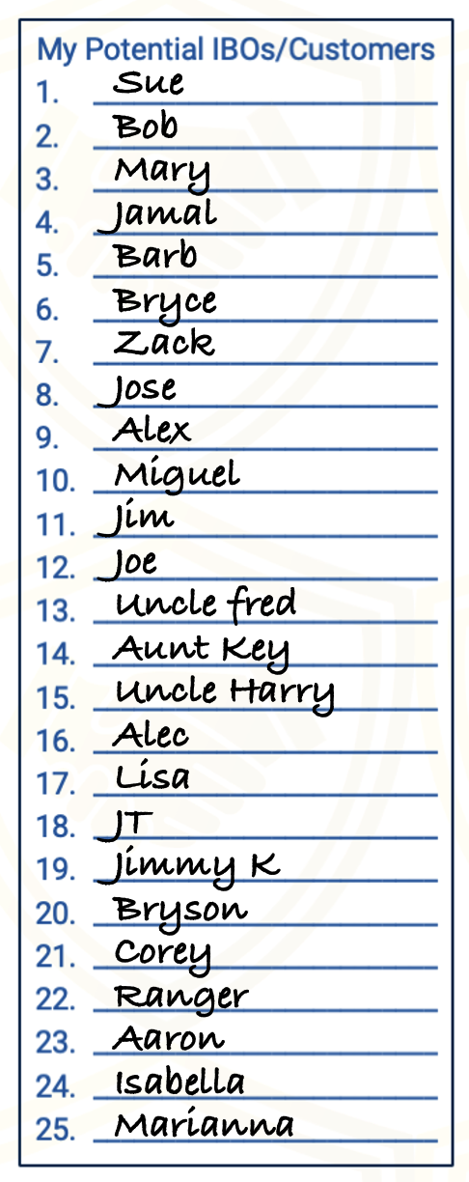
THE PIPELINE
E
X P O S U R E
#1
E
X P O S U R E
#2
E
X P O S U R E
#3
Conversation
Video Presentation
Zoom Presentation
Home Event
3-way Call
✔️ SORT
Training
3-way call
Team Event
Explain Comp Plan
Coach & Cowboy
✔️ SORT
Training Materials
3-way call
Share Services
Explain Comp Plan
Meet Leadership
✔️ SORT
IBO
Pique
Invite
3-Way Call
Customer
On The Fence
______________________
______________________
______________________
Referral
Jim the Financial Planner
Sue the Investor
Jim the Single Dad

Slide 3
MANAGE YOUR PIPELINE
LIST
TAKE ACTION
MOMENTUM
FOLLOW UP
RESULTS
KEEP FILLING
Piquing
Inviting
3-Way Calls
S ❌ M = MO
5-12 Times
HOW
LONG?
S = Speed
M = Mass

Slide 4
TAKE ACTION
MyPathToETL.com

