Slide 1
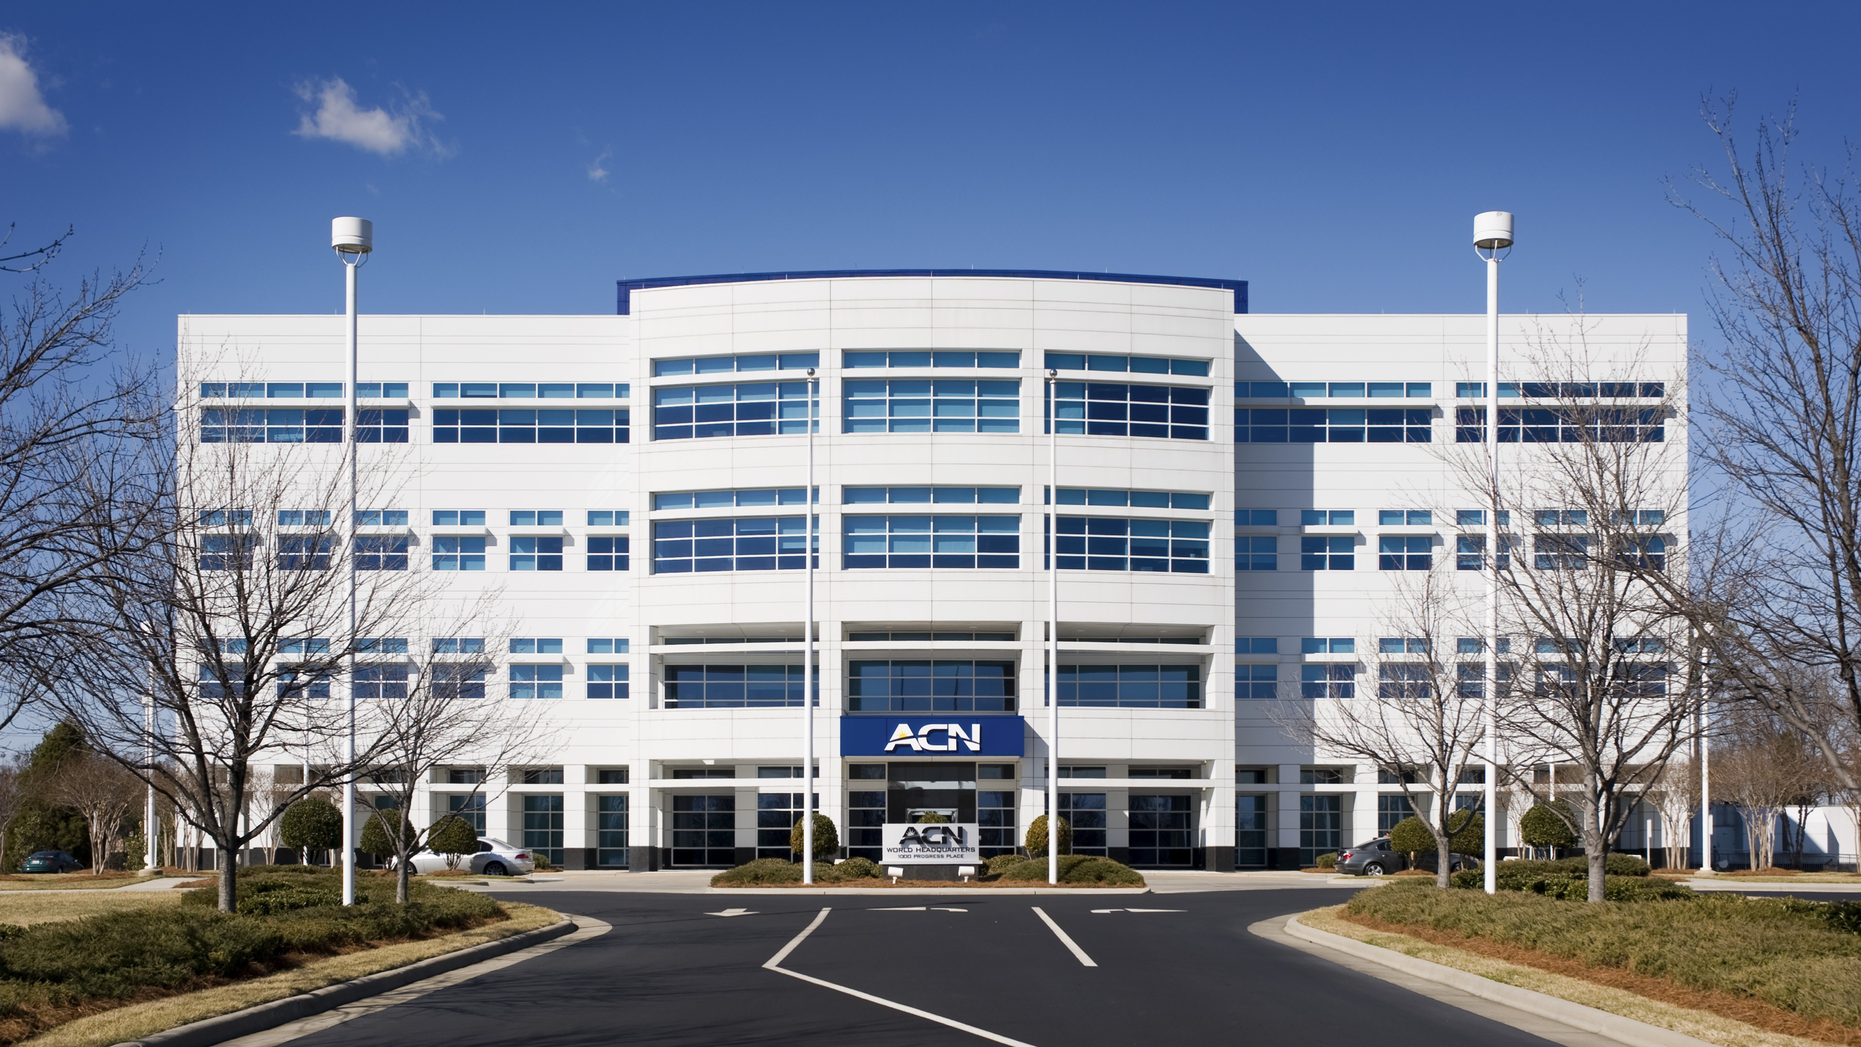

Slide 2
Refer to the ACN Compensation Plan for complete details. Earnings as an ACN IBO are based solely upon the successful sale of products to customers and their usage of those products. Individuals will incur expenses in operating their ACN business, such as the sign-up and monthly business support fees, as well as other possible operating expenses. As with any business, earnings and success at ACN are not guaranteed but depend primarily on the individual’s persistence, effort and results of acquiring customers personally and/or through their team. Individuals will not earn income and will lose money as an IBO if customers are not acquired.

Slide 3
Customer Acquisition
Specialists
Established
In 1993
Millions of
Customers Acquired
Billions
In Sales

Slide 4
Customer Acquisition
Specialists
Established
In 1993
Millions of
Customers Acquired
Billions
In Sales

Slide 5
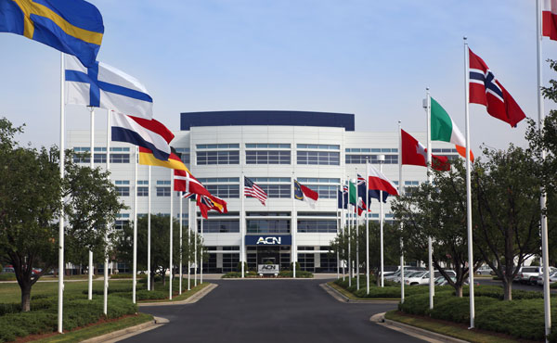
ESSENTIAL SERVICES
Residential|Business
Trusted Partners
TELEVISION
ENERGY
HIGH SPEED INTERNET
HEALTH
COVERAGE
MOBILE
SECURITY &
AUTOMATION
CLOUD SOLUTIONS
PAYMENT
PROCESSING
PAYROLL
SOLUTIONS
TRAVEL
ID THEFT
PROTECTION

Slide 6
COMPARE THE DIFFERENCE
Traditional Health Insurance
*
High Monthly Premiums
Up to 30%-50% Savings Per Month
High Deductible Per Family Member
Annual PRA as low as $2,500 Per Household
Must Choose From a Specified Network of Physicians and Facilities
Choose Your Physician/Facility
(Not Stuck with a Network)
RX Pricing
Lower RX Pricing + Portal
Higher Co-shares, Co-Pays and Provider Fees
Lower Co-Pays, Co-Shares and Provider Fees
Extra Cost for Telehealth or Not Available
Included 24/7 Telehealth - $0 Fee
Does not cover Migrants in the US
Mexico, Guatemala and Canada with no SSN – millions of people
*See Impact Website, Pricing and Guidelines for Full Details

Slide 7
HEALTH & WHOLENESS CREDIT
$100 monthly credited towards PRA
DENTAL & VISION
DISCOUNTS
Included
at No Additional Cost
DPC (Direct Primary Care) memberships
Naturopathic Medications/Supplements
Acupuncture
Services rendered by Naturopathic Providers
Gym Memberships

Slide 8
EARN BONUSES
To Cover Your Services*
REFER-A-FRIEND
POWERUP
REFER-A-FRIEND
Refer 12+ XOOM Energy Residential
Natural Gas or 12+ XOOM Energy Electricity customers and receive a bonus equal to the average commodity-only charges of your customers’ bills.
Enroll & authenticate 5+ customers with an IDSeal Annual plan and receive a bonus equal to the cost of your Annual service.*
Refer 5+ Flash Mobile customers and earn a FREE** line of service.
IMAGINE HOW MUCH YOU CAN SAVE YEAR AFTER YEAR!
*Refer to the ACN Compensation Plan for complete details!
**Excludes taxes and surcharges. Terms and conditions apply.

Slide 9
TRADITIONAL
BUSINESS MODEL
YOU
Most Service Providers
Media & Online Marketing
CUSTOMERS
Income Opportunity for You
More Choices for Consumers

Slide 10
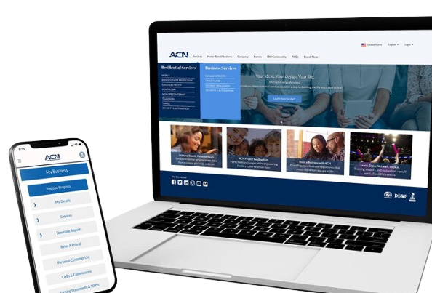
BECOME an Independent Business Owner (IBO)
$299 Start-Up + $25/month Business Support
All we do:
Personalized Website
Enroll customers
Help others to do the same thing
Training and Marketing Materials
Business Tracking and Reporting
IBO & Customer Support
ACN Loyalty Reward Program

Slide 11
Income from YOUR Personally Acquired Customers*
1
2
Monthly Customer Bonuses
Monthly Residual Income
Acquire Customers Totaling:
Earn Monthly On Your Customers
3 Services = $100
5 Services = $200
8 Services = $400
11 Services = $600
3% to 20%
Commissionable Revenue*
Plus $200
for Every Additional 3 Services*
Paid monthly on your customers Monthly Commissionable Revenue*
*Refer to the ACN Compensation Plan for complete details!

Slide 12
Income from YOUR Team’s Acquired Customers*
Overriding Customer Acquisition Bonuses
Earned once, when your team becomes customer qualified
CQ
ETL
RC
RD
RVP
SVP
SVP
Platinum
Up to
$150
Up to
$250
Up to
$350
Up to
$400
Up to
$450
$50
Overriding Residual Income
Paid monthly on customers your team enrolls
Up to
4%
Commissionable Revenue
*Refer to the ACN Compensation Plan for complete details!

Slide 13
I’m Ready To Get Started
Training & Support
ENROLL
AS AN IBO (Independent Business Owner)
Get with the person who invited you
and they’ll send you a link to their website!
PARTICIPATE
IN TRAINING
1
2
UTILIZE SUPPORT SYSTEM
ACN Online Presentations & Trainings
Your Team’s In-Person & Virtual Events
ACQUIRE
CUSTOMERS
&
BUILD A TEAM
3
4
IN BUSINESS FOR YOURSELF, NEVER BY YOURSELF!

Slide 15
NEW IBO TRAINING
The SYSTEM for how to maximize earnings for you and your team!
Earn Bonuses
Promote to First Leadership Position
Build Your Team
Supercharge Your Business

Slide 16
&
New IBO On Boarding
Important Links to Bookmark
Critical “To Do” Items
Team Events
***Access to Team Emails
LegacyPartners.Biz

Slide 17
🏠
🗓️
Set A Date In The
Next 24 Hours
PICK A TIME THAT
WORKS FOR YOU
Home Event
Build Relationships
Fluid Conversations
Networking
Follow Up Conversations
Relaxed Environment
Virtual Event
Attendees can join from a distance
Less time-consuming
Attendees can watch from home
Weather is not an issue
LAUNCH
Your Business
Your “A” List
Business Owners
Network Marketing Experience
$100,000 Earners
Everyone Else
LegacyPartners.biz
TheSVPSystem.com
Notes:
Now that you know what to do, let's talk about how to do it.
LAUNCH YOUR BUSINESS!

Slide 18
THE PATH TO ETL
5
YOU Get
Teach and Help
To Do the Same
2
LegacyPartners.biz
TheSVPSystem.com

Slide 19
Scan and Download Now
MyPathToETL.com
Launch Your Business
Enroll Services
Become Customer Qualified (CQ)
Earn Your First 2 Personal Customer Bonuses Totaling $200*
Build Your Team
Promote to ETL and Earn the ETL in 30 Days Bonus - $400*
Qualify for ETL Customer Acquisition Bonuses*
*Refer to the ACN compensation plan for complete details.
LegacyPartners.biz
TheSVPSystem.com

Slide 20
Sue
Bob
Mary
Jamal
Barb
Bryce
Zack
Jose
Alex
Miguel
Jim
Joe
Uncle fred
Aunt Key
Uncle Harry
Alec
Lisa
JT
Jimmy K
Bryson
Corey
Ranger
Aaron
Isabella
Marianna
You = 5 Services
You = 3 Services
Personal Customer Bonus
$200
Personal Customer Bonus
$100
Team = 10 Services
You – XOOM
You – IDSeal
You – Truvvi
Total = 15 Services
ETL in 30 Days
$400
$600
Sue – Electric
Bryce – IDSeal
Zack
Barb
5
5
XOOM
IDSeal
Truvvi
IMPACT
Flash
XOOM
Impact
Flash
Flash
Dish
5
LegacyPartners.biz
TheSVPSystem.com
*See ACN Compensation Plan for full details. Your results may vary. Earnings are not guaranteed.

Slide 21
LAUNCH/GRAND OPENING SCRIPT
Works Well for a New IBO with little experience.
Hi, ________________. I just have a minute, but I wanted to call and let you know I started a business and I’m having my launch/grand opening on (Day/Date/Time)_________ and would love for you to attend just to support me. I just need to have ____ people so I can have a successful launch. Can I count on you to help me out and attend?
LegacyPartners.biz
TheSVPSystem.com

Slide 22
INVITATION - SAMPLE SCRIPT – PRACTICE IT!
Start by asking:
“Do you keep your options open for making additional income?”
Share
Show
Only
Just
May
May Not
Two
Choices
LegacyPartners.biz
TheSVPSystem.com

Slide 23
😎
💥 Be New
💥 Talk about a person, not the thing
💥 Essential Services
💥 3-Way Call
😬
What If They Have Questions…
LegacyPartners.biz
TheSVPSystem.com

Slide 24
YOUR
BUSINESS LAUNCH
LegacyPartners.biz
TheSVPSystem.com

Slide 25
Launch Checklist
Send a Text Reminder TO YOUR GUESTS At Least 2 hours prior 15 minutes prior for Zoom
Well-Lit Room LIGHTS ON Home Ready for Guests
Professional Background CAMERA ON! Your Guests are watching you
Test ALL YOUR TECH
Mic/Web Cam or TV Connection
Role of Host FILL THE EVENT & INTRODUCE the speaker and opportunity with enthusiasm
Pay Attention TO THE SPEAKER! No distractions, no pets, no kids
LegacyPartners.biz
TheSVPSystem.com

Slide 26
YOUR FIRST ACN BUILDING BLOCK
$200
5 Services
+$400
$600
Zack
Barb
5 Services
5 Services
LegacyPartners.biz
TheSVPSystem.com
*See ACN Compensation Plan for full details.
Your results may vary. Earnings are not guaranteed.
Notes:
Quick Start
Build Confidence - You and Company
Get Paid
$500 Bonus for enrolling 30 customers between you and your team
Specifics from the person who enrolled you or invited you.
*****Now that you know what to do, let's talk about how to do it.

Slide 27
CONGRATULATIONS!!!
ETL
$50
5 Services
5 Services
$50
$50
5 Services
5 Services
$50
$50
$50
5 Services
5 Services
LegacyPartners.biz
TheSVPSystem.com
*See ACN Compensation Plan for full details.
Your results may vary. Earnings are not guaranteed.
Notes:
Quick Start
Build Confidence - You and Company
Get Paid
$500 Bonus for enrolling 30 customers between you and your team
Specifics from the person who enrolled you or invited you.
*****Now that you know what to do, let's talk about how to do it.

Slide 28
TELEVISION
ENERGY
HIGH SPEED INTERNET
HEALTH
COVERAGE
ACQUIRE CUSTOMERS
MOBILE
SECURITY &
AUTOMATION
CLOUD SOLUTIONS
PAYMENT
PROCESSING
PAYROLL
SOLUTIONS
TRAVEL
ID THEFT
PROTECTION
LegacyPartners.biz
TheSVPSystem.com
Notes:
Your goal when you get started is to get in the black ASAP

Slide 29
Monthly Personal Customer Bonuses
(Based off any Customers YOU Acquire)*
5 Services & 10 Points = $200
8 Services & 16 Points = $400
11 Services & 22 points = $600
PLUS $200 for Every Additional
3 Services & 6 Points
LegacyPartners.biz
TheSVPSystem.com
*Refer to the ACN Compensation Plan for complete details!
Notes:
Your goal when you get started is to get in the black ASAP

Slide 30
Sources for Customers
Who can become your customer?
YOU
Prospects Who Don’t Become IBOs
People You Do Business With
Family
&
Friends
LegacyPartners.biz
TheSVPSystem.com
Notes:
Four Sources of Customers
The Most Important Customer is YOU

Slide 31
How to Get Additional Customers…
Ask for favor
Favor
Why
Friends and Family
Favor-Why-Help-Try
Can you do me a small favor and try a service. I started a side business to get out of debt. Can I count on your help?
Help
Try
LegacyPartners.biz
TheSVPSystem.com

Slide 32
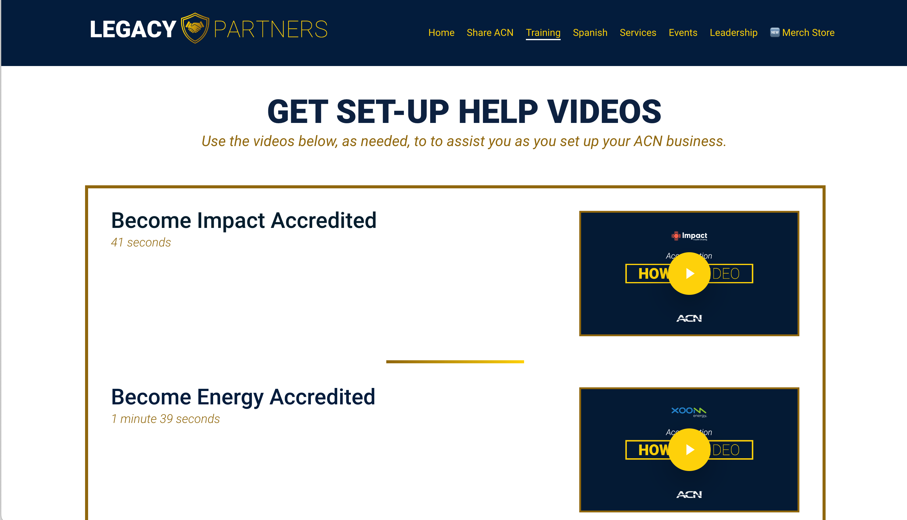
Become Impact & Energy Accredited
Go to:
LegacyPartners.biz > Training > New IBO > Get Set Up
Scroll to “Become Impact Accredited” and “Become Energy Accredited”
LegacyPartners.biz
TheSVPSystem.com

Slide 33
MINDSET
LegacyPartners.biz
TheSVPSystem.com

Slide 34
BE A PROFESSIONAL
SORTER
Sorting is Fun! No one likes being convinced Be a Professional Listen, Sort and Move On SW, SW, SW, SW, NEXT!
Some Will, Some Won’t, So What, Someone’s Waiting!
LegacyPartners.biz
TheSVPSystem.com

Slide 35
CONGRATULATIONS!!!
ETL
RC
$50
$150
5 Services
5 Services
$50
$150
$50
$150
5 Services
5 Services
$50
$150
$50
$150
$50
$150
5 Services
5 Services
LegacyPartners.biz
TheSVPSystem.com
*See ACN Compensation Plan for full details.
Your results may vary. Earnings are not guaranteed.
Notes:
Quick Start
Build Confidence - You and Company
Get Paid
$500 Bonus for enrolling 30 customers between you and your team
Specifics from the person who enrolled you or invited you.
*****Now that you know what to do, let's talk about how to do it.

Slide 36
IBOs WITH A START DATE IN 2024

Slide 37
How to Promote to
Regional Coordinator
Watch in our FB Group
LegacyPartners.biz
TheSVPSystem.com

Slide 38
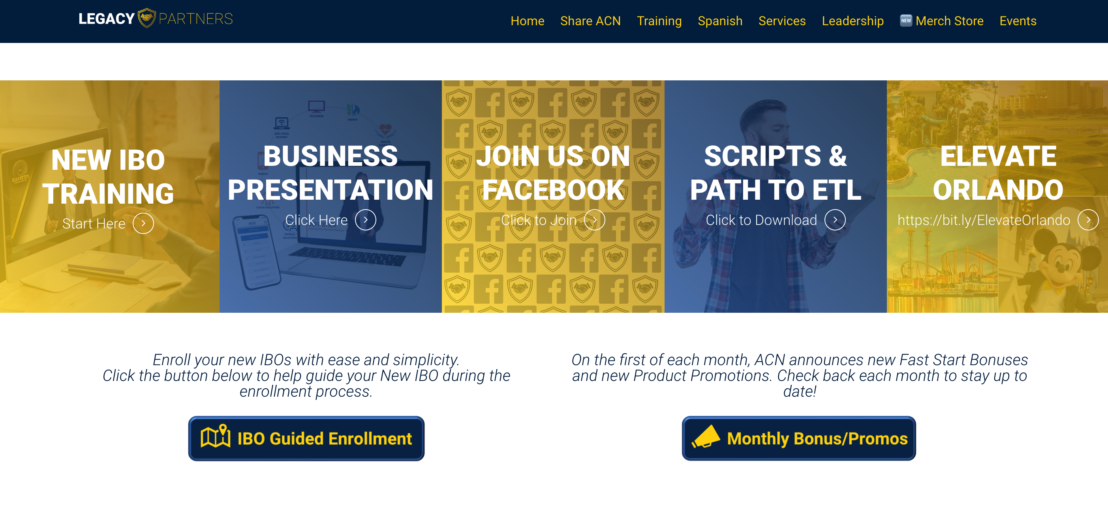
GET
CONNECTED

Slide 39
CALL TO ACTION!
🏆
1
2
3
Set up your
BUSINESS LAUNCH
HOME or ZOOM
Invite your guests to your LAUNCH.
Use the scripts provided on
LegacyPartners.Biz
Identify and Acquire your first
5 SERVICES
right away and
BUILD YOUR TEAM
LegacyPartners.biz
TheSVPSystem.com

Slide 40
Guests are welcome for all events.
New IBO Trainings are preceded by a short business overview.
The Healthcare Coverage informational Zoom will be followed by a short business overview
SUNDAY
MONDAY
TUESDAY
THURSDAY
SATURDAY
7:00 p.m. CT
7:00 p.m. CT
7:00 p.m. CT
7:00 p.m. CT
9:00 a.m. CT
NEW IBO TRAINING
HOW TO:
Get Qualified
Get Paid
Build Your Team
NEW IBO TRAINING
HOW TO:
Get Qualified
Get Paid
Build Your Team
BUSINESS PRESENTATION
Invite Your Guests
Guests can register to attend at
HealthCoverageRedefined.com
IBOs Plug In
Every Sunday
Also great for guests!
Have a goal to have at least one guest on
each week!
New IBOs MUST be on this training as soon as they enroll!
Perfect for potential Impact customers.
Includes Q&A
New IBOs MUST be on this training as soon as they enroll!
LegacyPartners.biz
TheSVPSystem.com

Slide 41
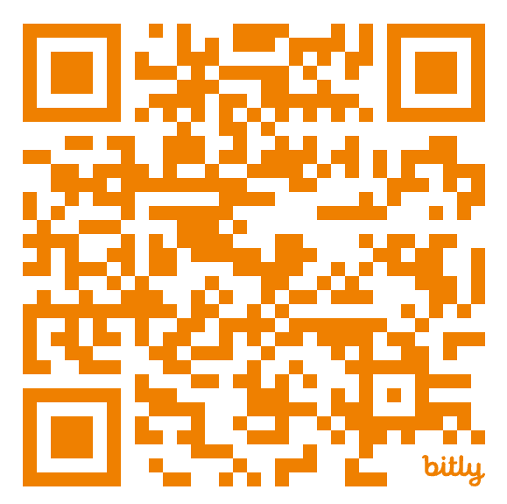
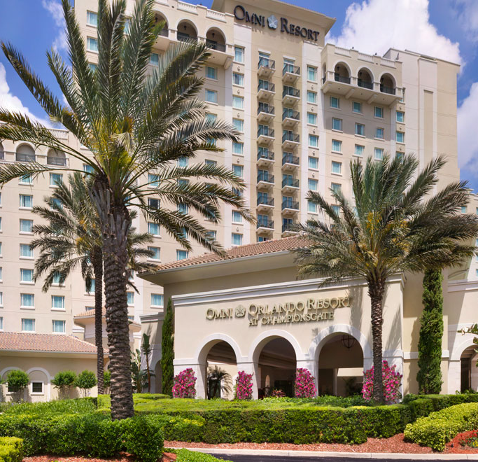
ORLANDO
October 12 – 13, 2024
www.ACNElevate.com

