Slide 1




Slide 2

Refer to the ACN Compensation Plan for complete details. Earnings as an ACN IBO are based solely upon the successful sale of products to customers and their usage of those products. Individuals will incur expenses in operating their ACN business, such as the sign-up and monthly business support fees, as well as other possible operating expenses. As with any business, earnings and success at ACN are not guaranteed but depend primarily on the individual’s persistence, effort and results of acquiring customers personally and/or through their team. Individuals will not earn income and will lose money as an IBO if customers are not acquired.

Slide 3


Slide 4

The Healthcare System is….

Slide 5




The avg individual in America pays $452 per month & avg family pays $1,779 per month
for marketplace (ACA) health insurance in 2021
The #1 reason for bankruptcies is due to medical issues and bills
A Tipping
Point

Slide 6

…what is it?
An Alternative to the high cost of Health Insurance

Slide 7
50%-70% Less Expensive
See any Dr you want….no network
Why
Impact?
Enroll any time of year
No license required to offer
Sharing economy is expected to grow to $335B in 2025

Slide 8
Non-Profit:
Eliminates the financial conflict that naturally exists between an Insurance Company and its Policy Holders
Non-Insurance:
Isn’t restricted by regulations and mandates that makes insurance expensive and too rigid
Targeted:
Ideally suited to healthy individuals and families with few pre-existing conditions
Intellectual
Argument

Slide 9
Comprehensive program for preventative services, maternity, accident, illness, injuries
24/7 Free Telemedicine: Industry-leading prescription savings program
Free annual physicals: $150 credit for labs/diagnostics
Industry
Leading
Features

Slide 10
The Solution…
+

Slide 11

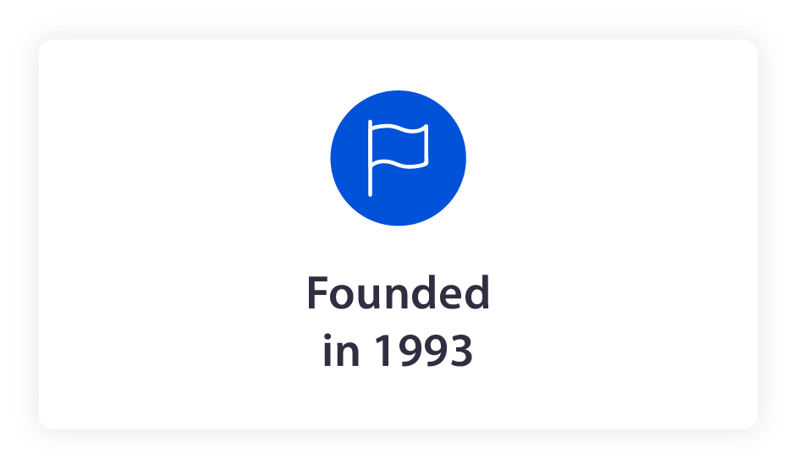
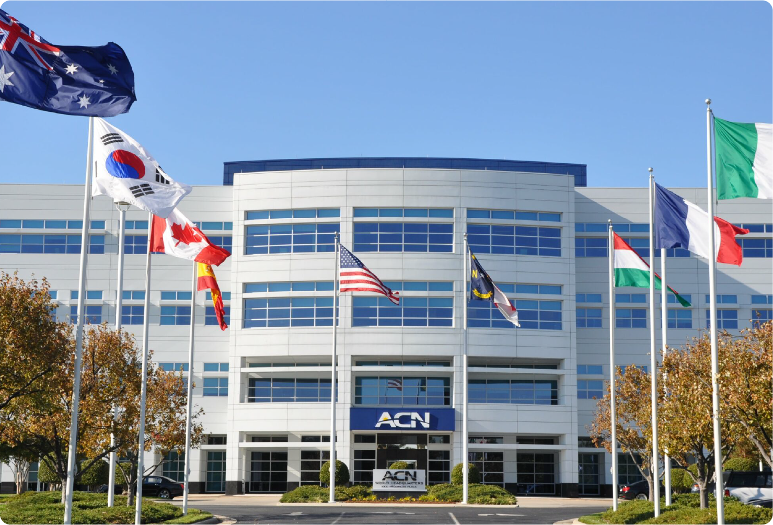
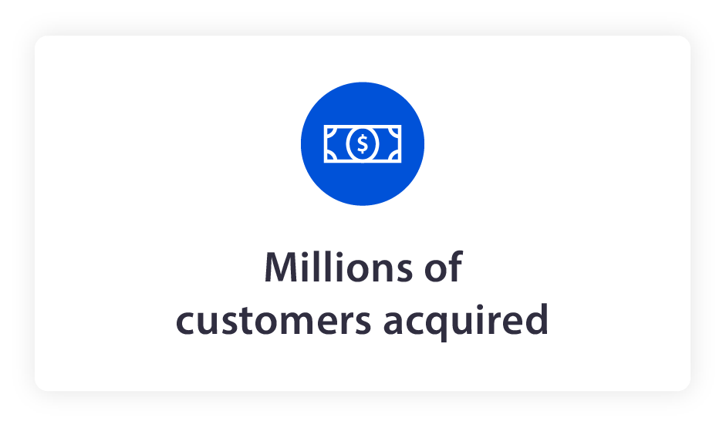
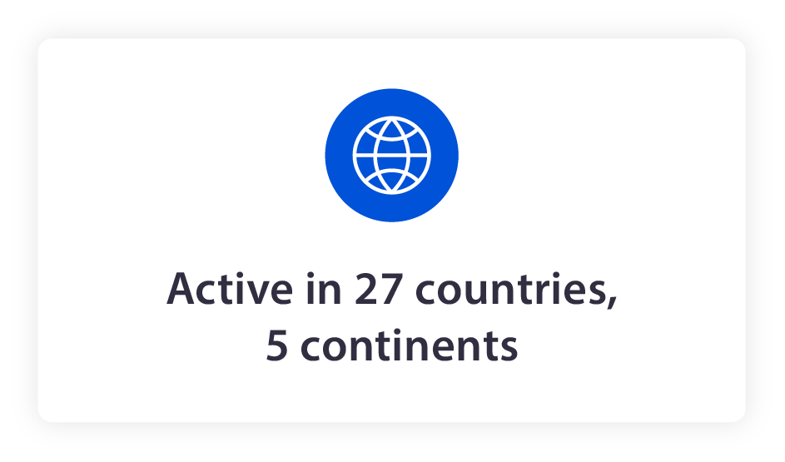

Slide 12


Slide 13


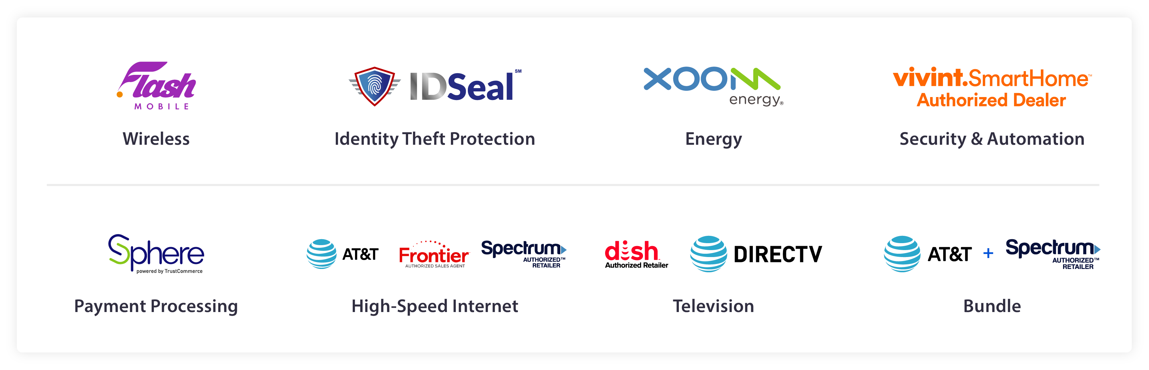


Health Sharing
Mobile
Energy
Identity Protection
Home Security & Automation
Payment Processing
High Speed Internet
Television
Bundled Services

Slide 14








Slide 15

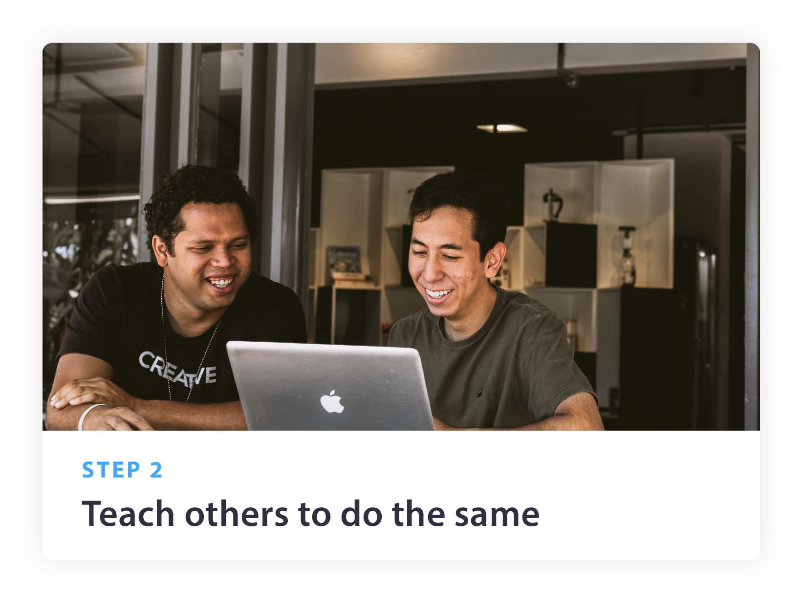
Simple Business Plan
Gather a few customers who save money
Show others how to make money

Slide 16
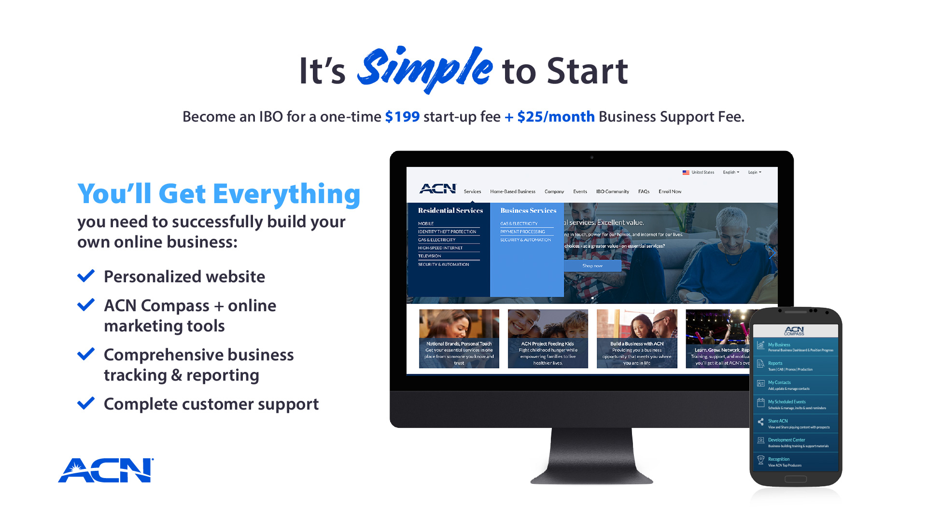
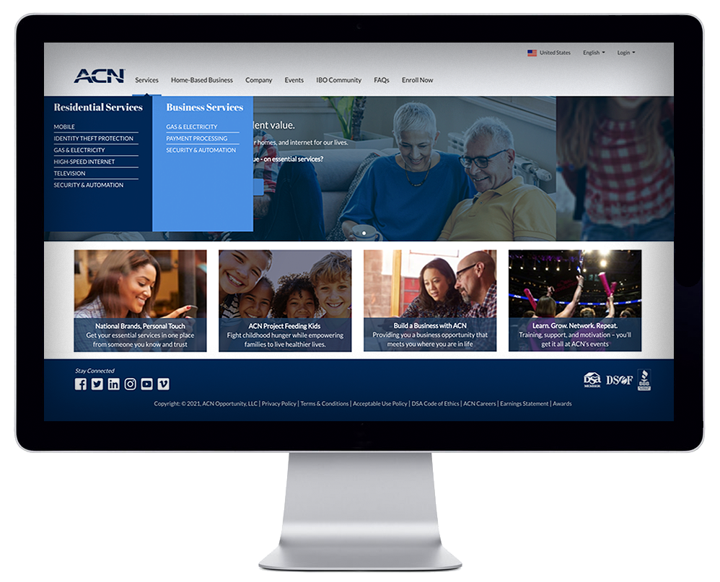

Slide 17
Income on Your
Personal Efforts

Slide 18
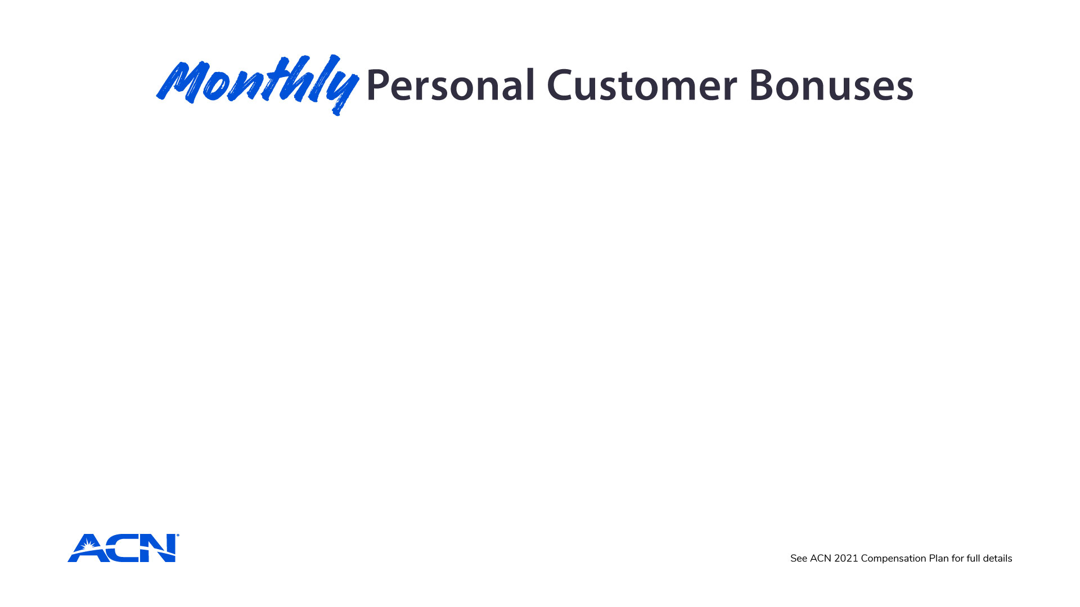
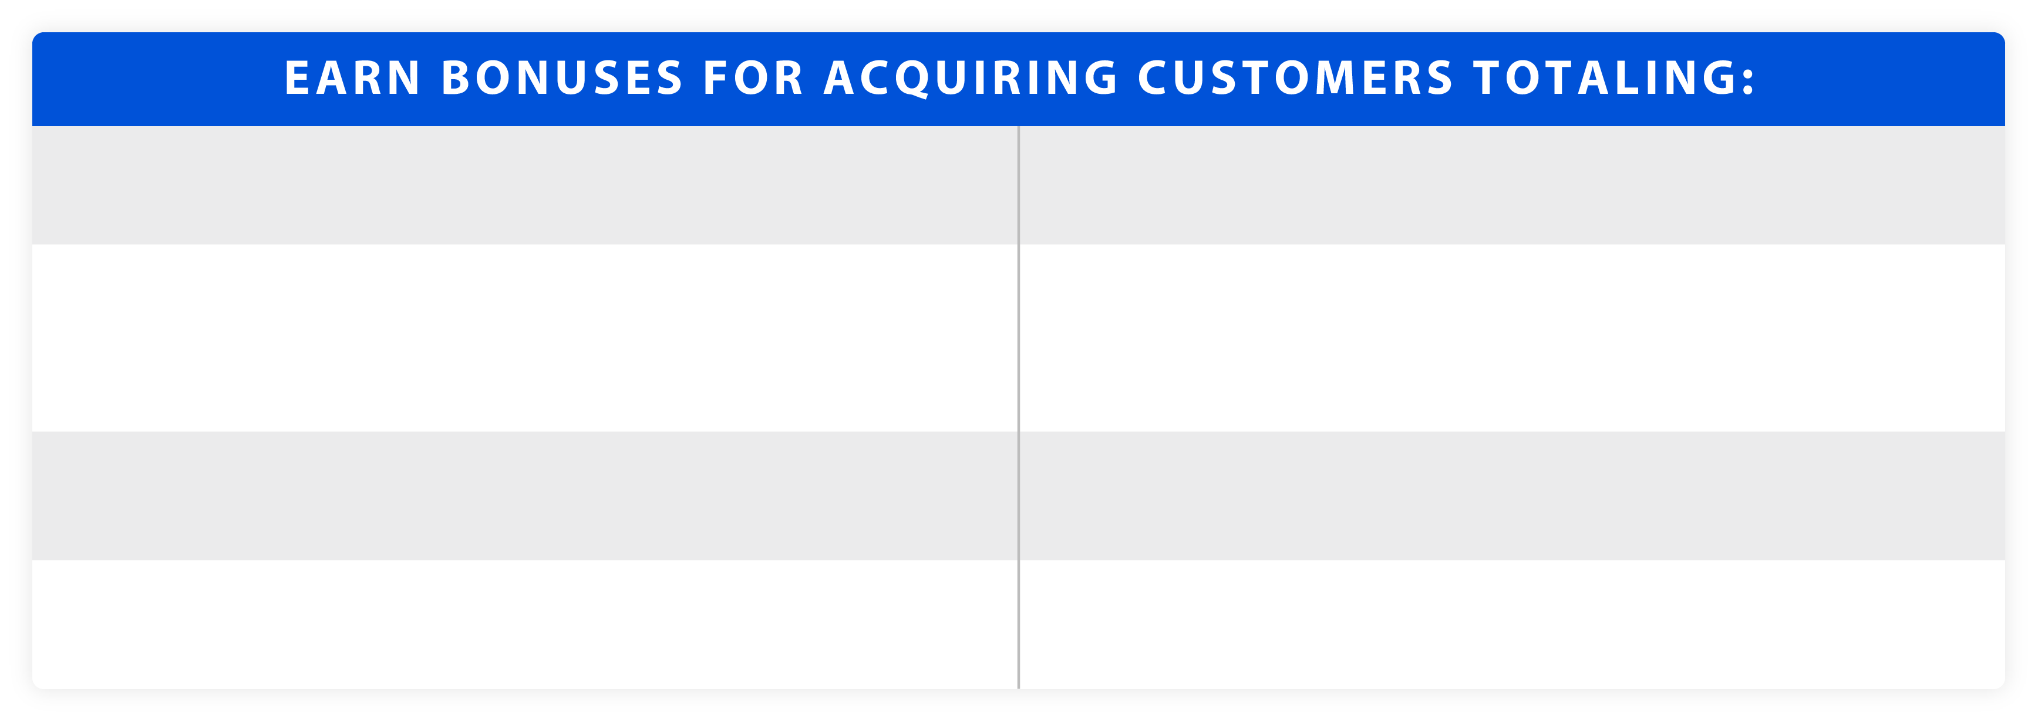




Slide 19
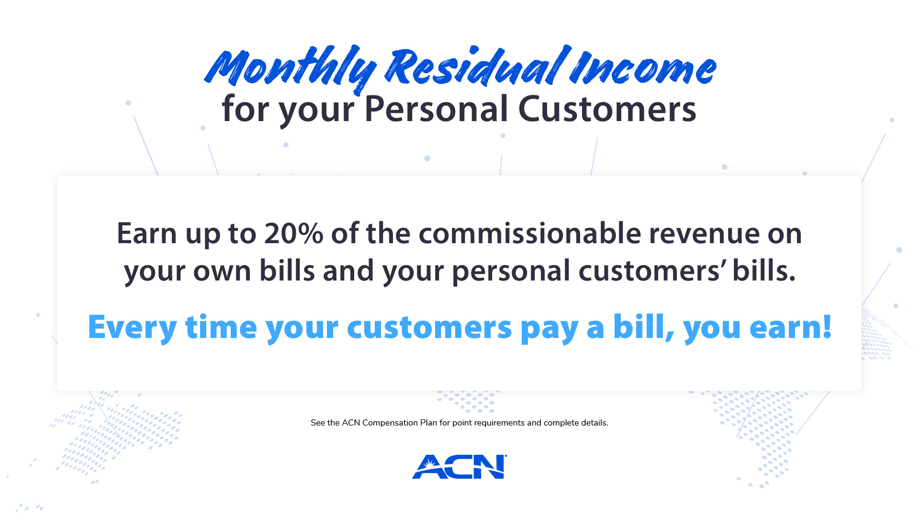

Slide 20
Income on Your
Team’s Efforts

Slide 21

Overriding Residual Income
4%
Customers Your Team Acquires Through 5 Levels
Refer to the ACN Compensation Plan for Complete Details

Slide 22
The Power of Leverage
 | YOU | 10
1 | 4 | 40
2 | 16 | 160
3 | 64 | 640
4 | 256 | 2560
5 | 1024 | 10240
 | 1364 | 13650
Level
Team IBOs
Team Customers
Total
84
840
Hypothetical example is provided for training purposes only. Not intended to represent typical results.
See ACN 2022 Compensation Plan for full details.

Slide 23
Team Customer Residual
100 Customers | $ 560 per month
500 Customers | $2,800 per month
800 Customers | $4,480 per month
1,000 Customers | $5,600 per month
3,000 Customers | $16,800 per month
Residual Income From Team Impact Customers
5 Level Residual
Based on $140 Average commissionable revenue from Impact Health Sharing Services only
See ACN 2022 Compensation Plan for full details.

Slide 24
Overriding Bonuses
$50
$150
$250
$350
Earn $50 to $350 for every new IBO who joins and becomes Customer Qualified in their first 30 days!
No bonuses are paid to anyone unless customers have been acquired.
Unlimited Residual
Incentive Trips
Increased Bonuses
Refer to the ACN Compensation Plan for Complete Details

Slide 25
Invite Your Guests
Every Week, Mondays thru Thursdays
  7:00 pm central
Saturdays
  9:00 am central
Women of Power Zoom
  Mondays at 11:00 am central
Send guests to
TRNZoom.com
Training site: http://RhinoNation.world

